Slide 1






BANK MARKETING
Analysis report
0001
Hathim Azman
Farah Syahirah
Azrul Zulhilmi
Adam Suhail
P153146
P151357
P153478
P153109

Slide 2
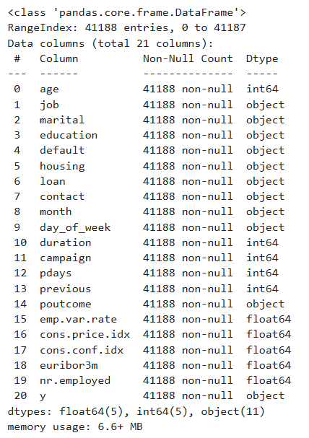

exploratory data analysis
About dataset
Data was obtained from the UCI Machine Learning Repository.
It reflects the results of direct marketing campaign conducted by banking institution.
These campaigns were carried out through phone calls and include a wide range of customer attributes.
The goal is to predict whether a customer will subscribe
to a term deposit based on various attributes.
dATASET CHARACTERISTIC
Classification, multivariate
41,188 instances
20 features (19 predictors)
11 categorical variables including target variable
9 numerical variables
y is our target variable, classification of both subscriber and non-subscriber to term deposit

Slide 3
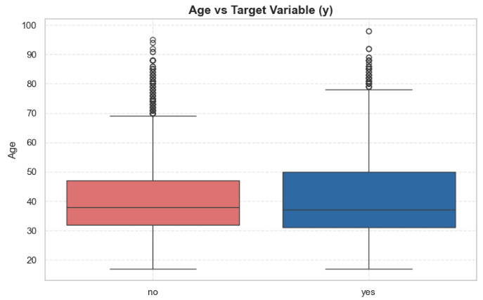
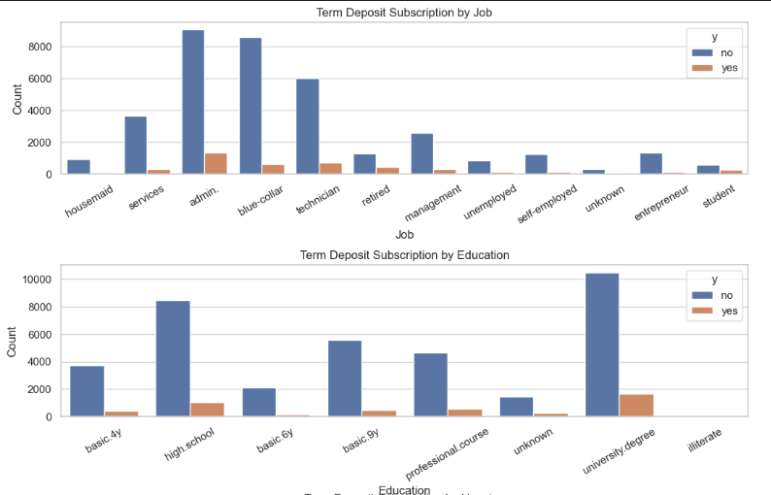
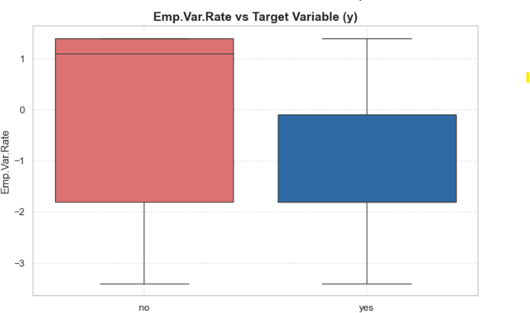
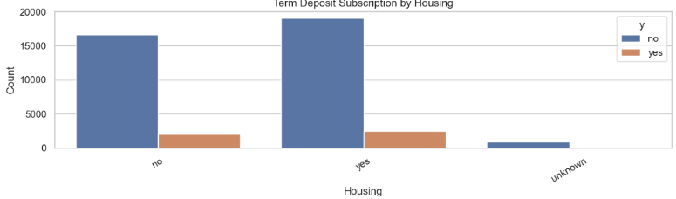
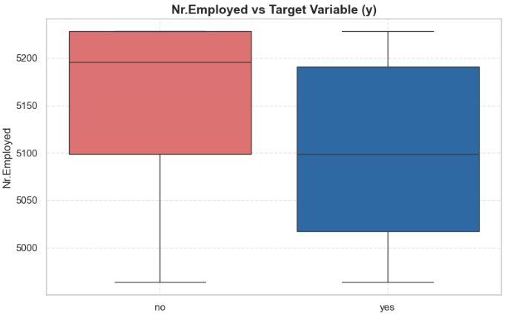
Target vs predictor

Slide 4
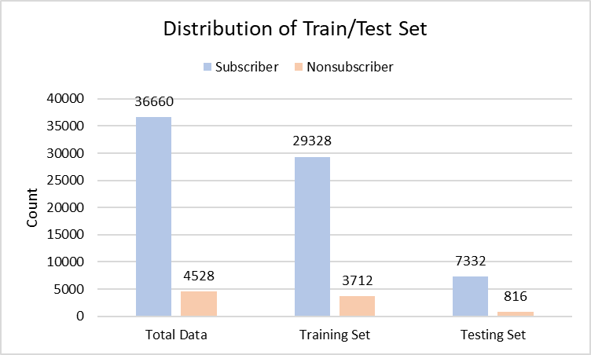

80%
20%

Slide 5

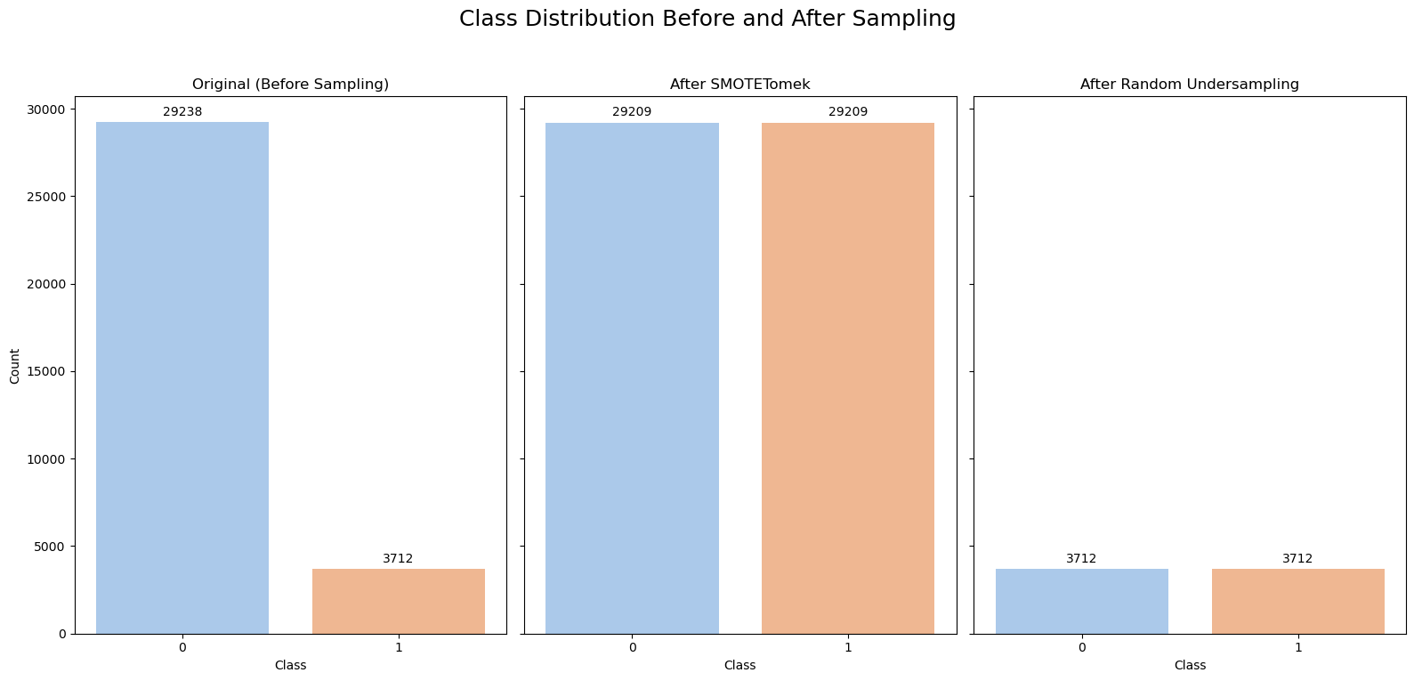
Addressing Imbalance
29,328 non-subscribers vs 3,712 subscribers
(approx 89% vs 11%)
Target Imbalance
Random Undersampling (RUS)
The subscribed class (1) is rare compared to non-subscribers (0)
Randomly removes examples from the majority class to equalize class sizes.
Synthetic Minority Over-sampling Technique.
SMOTE + Tomek Links
SMOTETomek combines SMOTE and Tomek Links to balance the classes and clean the data. It adds synthetic minority samples and removes borderline majority samples, reducing noise and improving model accuracy (Batista et al. 2004).
Class Weight Adjustment
Reference: Batista, Gustavo & Prati, Ronaldo & Monard, Maria-Carolina. 2004. A Study of the Behavior of Several Methods for Balancing Machine Learning Training Data. SIGKDD Explorations. 6. 20-29.

Slide 6
performance metrics of models + Sampling Methods
# | Model | Sampling / Class Strategy | Classifier
1 | Baseline + Logistic Regression | No Sampling | Logistic Regression
2 | Baseline + Decision Tree | No Sampling | Decision Tree
3 | RUS + Logistic Regression | Random Undersampling | Logistic Regression
4 | RUS + Decision Tree | Random Undersampling | Decision Tree
5 | SMOTE Tomek + Logistic Regression | SMOTETomek (Oversample + Clean) | Logistic Regression
6 | SMOTE Tomek + Decision Tree | SMOTETomek (Oversample + Clean) | Decision Tree
7 | CWA + Logistic Regression | Class Weight = 'balanced' | Logistic Regression
8 | CWA + Decision Tree | Class Weight = 'balanced' | Decision Tree
Accuracy | Overall correctness of predictions (both 'yes' and 'no')
Precision | How many predicted 'yes' were actually correct — minimizes false positives
Recall | How many actual 'yes' were correctly predicted — minimizes false negatives
F1-Score | Harmonic mean of precision and recall — balances both concerns
AUC (ROC) | Area under the ROC curve — measures ability to rank positives above negative

Slide 7
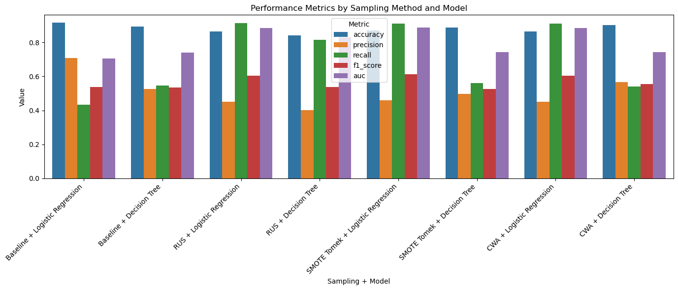
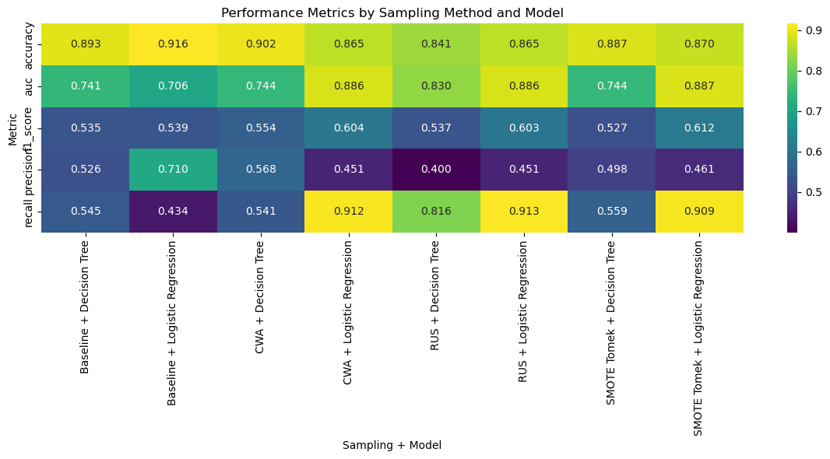
Metric | Value
Accuracy | 0.8699
Precision | 0.4607
Recall | 0.9095 ✅
F1-Score | 0.6116 ✅
AUC | 0.8872 ✅
Best Model Based on Metric:
SMOTE TOMEK + Logistic Regression

Slide 8

Implications through simulation
A naive approach is to contact all 100,000 customers without adjusting to possible True Positives or False Positives, and compare them to different models.
Simulation parameters:
🧍 100,000 Simulated Customers
🎯 Customer Conversion Rate : 5%
💰 Advertisement Cost for 1 Customer : RM 1
📈 Profit for Successful Conversion : RM 25
Metric | Formula | Description
Contacted | True Positive + False Positive | Total customers the model predicts as positive and are contacted
Model Gain (RM)** | True Positive * Profit for Successful Conversion | Revenue from correctly predicted conversions
Model Lost (RM)** | False Negative * Profit for Successful Conversion | Potential revenue lost from missed actual positives (not contacted)
Model Cost (RM)** | Contacted * Advertisement Cost | Total cost of contacting customers
Model Revenue (RM) | Model Gain - Model Cost | Revenue after deducting contact cost
Model Value (RM)** | Model Gain - Model Cost - Model Lost | Net business value considering both cost and missed opportunities

Slide 9

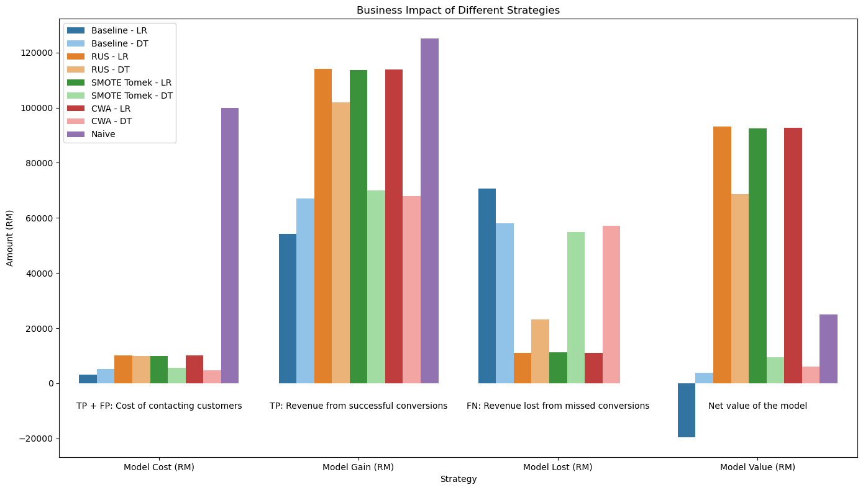
Baseline models may have high Accuracy and Precision but perform worse than other models!
Adjusting for imbalance allows models to recover minority signals, leading to higher true positives(^) and much lower false negatives(*).
^
^
Adjusting for class imbalance improves precision and recall. A balanced approach is F1-score / AUC. Improving Model Value.
*
*

Slide 10
What does this mean?
Random Under Sampler - Logistic Regression shows best performance
Adjusting for class imbalance allows model to more accurately find true positives
No single metric is the best at identifying best model
Understand the objective of modelling, ie; lowest cost/highest profit/most accurate model.

